Slide 1
RISK MANAGEMENT
UNIT – IV

Slide 2
Contents
Risk management planning
Risk Management Activities
Common sources of risk on information technology projects
Risk identification
Qualitative risk analysis & Quantitative risk analysis
Risk response planning
Risk monitoring and control

Slide 3
Risk
A risk is any uncertain event or condition that might affect your project.
Risk is a function of two components:
The Probability of occurrence
The Consequences (what’s at stake)
Risk is inevitable in a business organization when undertaking projects. However, the project manager needs to ensure that risks are kept to a minimal.
Risks can be mainly divided between two types, negative impact risk and positive impact risk.
Some events (like finding an easier way to do an activity) or conditions (like lower prices for certain materials) can help your project. When this happens, we call it an opportunity; but it’s still handled just like a risk.
Once the risk has been identified, project managers need to come up with a mitigation plan or any other solution to counter attack the risk.

Slide 4
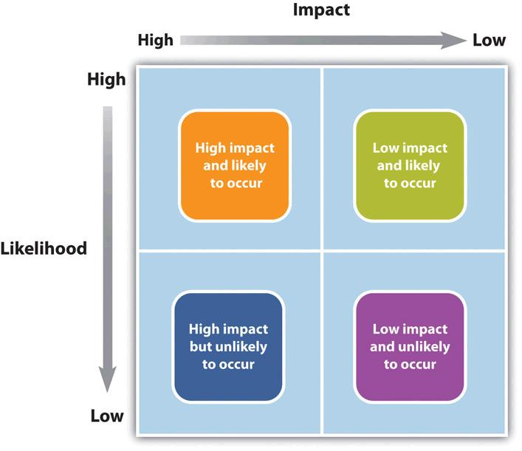
Risk and Impact

Slide 5
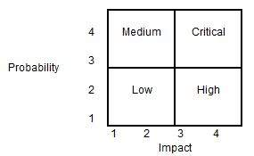
Risk Quantification
Risks can be evaluated based on quantity. Project managers need to analyze the likely chances of a risk occurring with the help of a matrix.
Using the matrix, the project manager can categorize the risk into four categories as Low, Medium, High and Critical. The probability of occurrence and the impact on the project are the two parameters used for placing the risk in the matrix categories. As an example, if a risk occurrence is low (probability = 2) and it has the highest impact (impact = 4), the risk can be categorized as 'High'.

Slide 6
Risk Management
Project risk management is the process of identifying, analyzing and responding to any risk that arises over the life cycle of a project to help the project remain on track and meet its goal.
Risk management isn’t reactive only; it should be part of the planning process to figure out risk that might happen in the project and how to control that risk if it in fact occurs.
A risk is anything that could potentially impact your project’s timeline, performance or budget. Risks are potentialities, and in a project management context, if they become realities, they then become classified as “issues” that must be addressed. So risk management, then, is the process of identifying, categorizing, prioritizing and planning for risks before they become issues.
On large-scale projects, risk management strategies might include extensive detailed planning for each risk to ensure mitigation strategies are in place if issues arise. For smaller projects, risk management might mean a simple, prioritized list of high, medium and low priority risks.

Slide 7
The Risk Planning Process
Risk planning is the process of identifying, prioritizing, and managing risk.
Every project or initiative has objectives, that is, goals that it seeks to accomplish. These are often called Critical Success Factors
Risk events threaten the successful completion of these critical success factors. Thus, risk planning involves identifying the most important risk events in advance, prioritizing them, and developing the appropriate risk response plans. There are three steps to risk planning:
Identifying Risks
Prioritizing Risks
Determining Response Plans

Slide 8
Risk Planning: Identifying Risks
A strong risk identification process is important to the successful completion of the critical success factors.
A Risk Management Plan is prepared which includes items such as:
Risk Register
Risk Breakdown Structure
Risk Analysis
The risk register is the itemized listing of most important risks and it becomes the cornerstone of the Risk Management Plan. It requires careful consideration of the project risks and what could affect the project’s critical success factors.
Here are a few ideas to ensure that each risk is identified: Use a Risk Breakdown Structure, develop a checklist, look at assumptions, previous project experience, expert judgment.
Obviously, it is not possible to list all project risks. Although you should endeavor to identify the most important ones, you cannot predict everything and your stakeholders do not expect you to.

Slide 9
Risk Planning: Prioritizing Risks
To create a strong risk management plan, risks must be analyzed and prioritized to determine which require the project manager’s time and attention, how often, and what resources are required.
Prioritizing risks ensures that stakeholders recognize the importance placed on their areas of concern which goes a long ways toward placating them.
Since risk has two components:
Risk = Probability x Impact
Each of these factors should be prioritized. The scale is not important, but it is often 1-10, low-medium-high, or a similar scale.
If your risk register is a table with the risks listed vertically (in rows), you would add two columns labelled probability and impact. Each risk gets a ranking of 1-10, or whatever scale you choose.
After the initial ranking, an overall prioritization is often helpful to stakeholders. You would multiply the probability and impact to get a risk level, and then sort the table from highest to lowest. Clearly you will be able to see which risks to focus your attention on.

Slide 10
Sample Risk Register
Risk | Probability | Impact | Priority | Trigger | Response Plan
Miss completion date due to inclement weather | 3 | 6 | 18 | Site foreman to decide | See below
Deficient materials arrive at site | 1 | 8 | 8 | Site foreman inspects material upon arrival and decides | Send material back for full refund

Slide 11
Risk Planning: Determine Risk Response Plans
The final piece of information that completes the risk register is a risk response plan.
Now that you’ve identified the triggers that allow you to quickly identify when a risk has occurred (or is occurring), the response plan gives you a head start in the response.
Some responses occur at the beginning of the project (when the risk planning process is taking place) and others occur when the risk event occurs.
They must contain an appropriate level of detail. For major risks a good action plan is necessary in advance and could warrant its own write up. For medium risks a small action plan could be placed within the risk register, and for small risks there could be no action plan at all.

Slide 12
Risk Planning: Determine Risk Response Plans
There are four possible responses to risk events:
Avoid. Eliminate the threat. For example, change the scope of the project, spin off a certain business unit, or change the objectives that the risk event is threatening.
Transfer. Off-load the risk to a third party. For example, buy insurance, issue a performance bond, or change the contract from a lump sum to a unit price (or vice versa).
Mitigate. Reduce the probability or impact of the risk event. For example, cover the project area to prevent work stoppages due to inclement weather, or purchase materials in advance to ensure they can be returned without threatening the project completion date.
Accept. Sometimes there is no other alternative than to proceed with the project and accept the risk. But producing documentation, holding meetings, and communicating the risk with stakeholders can go a long ways toward minimizing the damage.

Slide 13
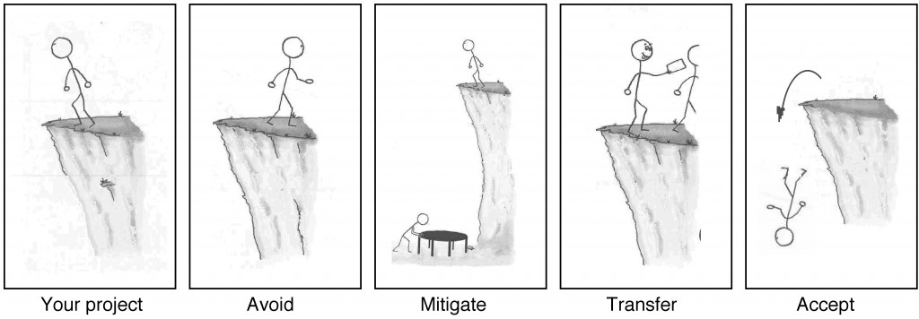
Risk Planning: Determine Risk Response Plans

Slide 14
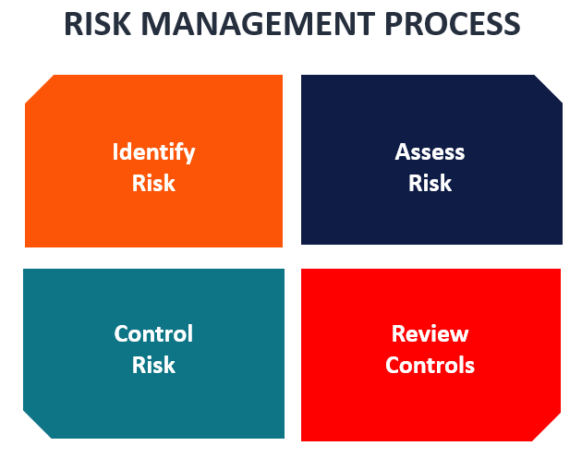
Risk Management Process
The risk management process involves five components.
The five components are:
Planning for risk
Identifying risks
Analyzing risks
Developing risk response strategies
Monitoring and controlling risks
Good risk management is proactive, not reactive, and seeks to reduce the probability of an adverse event occurring as well as the magnitude of its impact.

Slide 15
Risk Planning
The project manager should develop a written risk management strategy which includes the methods used to execute a project’s risk management plan.
Adequate resources need to be available to manage risk.
The key to writing a good Risk Management Plan is to provide the necessary information so the project team knows the objectives, goals, tools and techniques, reporting, documentation, and communication roles and responsibilities.

Slide 16
Identifying Risks
Project risks should be examined to a level of detail that permits an evaluator to understand the significance of the risk and its root causes and to potentially examine those root causes. Surveys of customers, end users, and other stakeholders could be beneficial.
Some typical risk categories are:
Cost – the cost of the project is higher than forecast, or increases during the project (scope creep)
Schedule – customers or end users are not given the final product within the agreed upon time frame
Technical – performance objectives are not met
Feasibility – the product is does not turn out to meet financial and/or business objectives.
Logistics – components do not arrive in time
Human Resources – project staff are not available, or lose availability
Production – concerns over packaging, manufacturing
Support – maintainability, operability, and trainability
Engineering – technical requirements for the product are too onerous, or not physically possible

Slide 17
Identifying Risks
Business – the financial metrics of the project change (demand slows, market prices change, etc.)
Contract – third party consultants/contractors/suppliers do not perform as anticipated, or did not interpret the contract the same way
Funding – the project cannot be funded to completion, or funding is removed part-way
Management – meddling in the project causes complications
Political – regulations change, or were not fully considered
Threat – Security, survivability, and vulnerability
Test – product tests are not set up correctly
Cost and Schedule risk are often the most likely to happen and require the most management resources.

Slide 18
Analyzing Risks
Risk analysis is the systematic process to estimate the level of risk for identified and approved risks.
Normally, this involves the creation of a risk matrix which quantifies the probability and consequence of the defined risks and a conversion to an overall risk level.
Qualitative Analysis
A commonly used qualitative risk analysis method involves risk scales for estimating probability of occurrence and a risk mapping matrix.
For each identified risk a probability and a consequence is assigned in the form of letters A to E. Each letter should be defined by a verbal description.
Then a risk mapping matrix is drawn up to categorize each risk.

Slide 19
Analyzing Risks
Quantitative Analysis
Two primary methods exist in order to perform a quantitative risk analysis:
Decision Tree Analysis
Monte Carlo Analysis
In a decision tree, the various outcomes are analyzed according to probability to come up with overall probabilities of all of the possible permutations.
The Monte Carlo process is an attempt to create probability distributions for potential risks and randomly sample them to quantify the risk.

Slide 20
Developing Response Startegies
In the Risk Management Plan (within the Project Management Plan) strategies to deal with each risk should be developed.
There are four ways to handle risk: Avoid, Transfer, Metigate, Accept

Slide 21
Monitoring and Controlling Risks
Within the Risk Management Plan, provisions should be in place to systematically track and evaluate the effectiveness of the risk response actions against established metrics.
Some techniques that can be used for monitoring and controlling risk:
Earned Value: This method compares the value of work completed to date (earned) with the value of work supposed to be performed at that point in the schedule. It is a technique to manage budget and schedule risk.
Program Metrics: Formal, periodic performance assessments evaluating whether the risk management plan is achieving its objectives.
Technical Performance Measurement (TPM): A way to measure the technical performance of a project and compare with the specifications required for project success.

Slide 22
Thank You!

